Slide 1

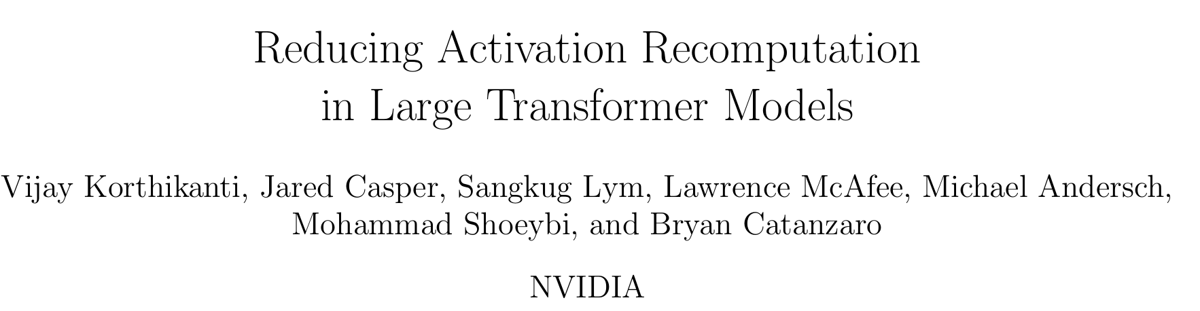
2024Fall CS598-AIE Yihe Zhang
13th Sept 2024

Slide 2
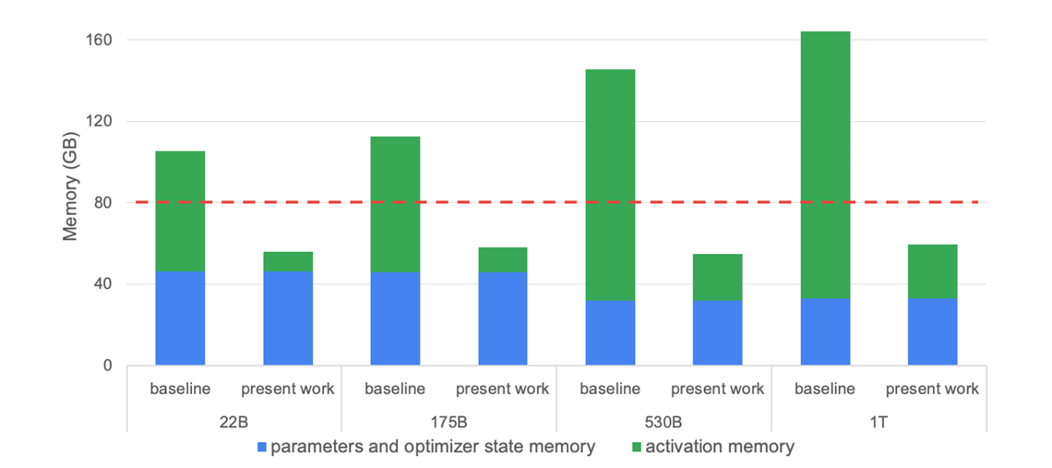
Booming Model, Bursting Memory
As the number of model parameters continues to grow, the memory demands on GPUs are skyrocketing. We‘re hitting the memory wall！
Present work: The standard approach to alleviate this memory pressure is to simply not store most of the activations and recompute them as necessary to calculate gradients during the backward pass.
Chen et al. (2016), Training deep neural networks with sublinear memory cost can significantly reduce memory requirements.
However, this method incurs a steep penalty of reducing training efficiency. In this paper we refer to this method as full activation recomputation. About 30 ~ 40% execution time overhead when full activation recomputation is used !!!
Korthikanti, Vijay Anand, Jared Casper, Sangkuk Lym, Lawrence McAfee, Michael Andersch, Mohammad Shoeybi, and Bryan Catanzaro. "Reducing Activation Recomputation in Large Transformer Models." In Proceedings of Machine Learning and Systems 5 (MLSys 2023). 2023.

Slide 3
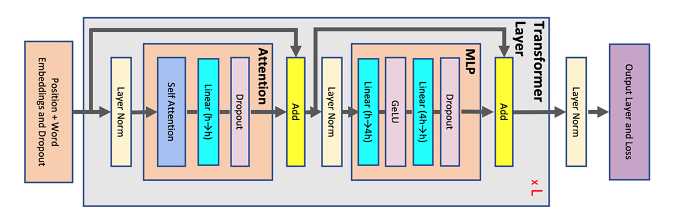
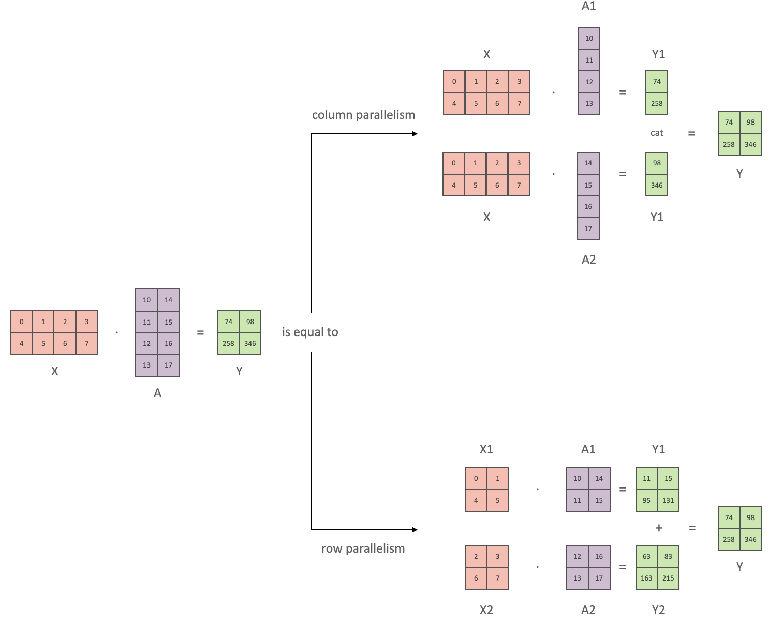
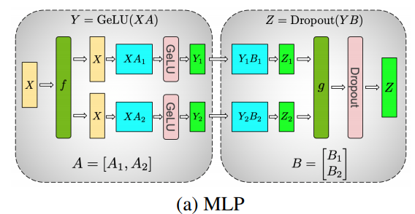
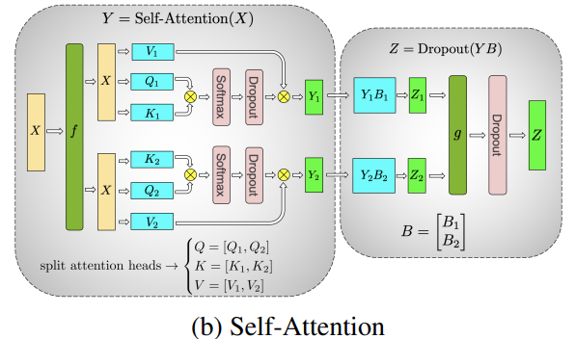
Booming Model, Bursting Memory
Model parallelism
1. Tensor parallelism, where parameters of each layer are distributed across many devices
Credits for: Model Parallelism (huggingface.co)
Korthikanti, Vijay Anand, Jared Casper, Sangkuk Lym, Lawrence McAfee, Michael Andersch, Mohammad Shoeybi, and Bryan Catanzaro. "Reducing Activation Recomputation in Large Transformer Models." In Proceedings of Machine Learning and Systems 5 (MLSys 2023). 2023.

Slide 4
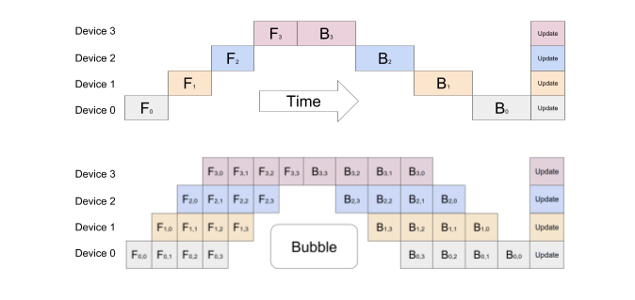
Booming Model, Bursting Memory
Model parallelism
2. Pipeline parallelism, where the model is split along the layer dimension of the network
Only help with the memory needed to store model parameters and optimizer state and cannot reduce the memory needed for activations while maintaining high device utilization.
Credits for: Model Parallelism (huggingface.co)
Korthikanti, Vijay Anand, Jared Casper, Sangkuk Lym, Lawrence McAfee, Michael Andersch, Mohammad Shoeybi, and Bryan Catanzaro. "Reducing Activation Recomputation in Large Transformer Models." In Proceedings of Machine Learning and Systems 5 (MLSys 2023). 2023.

Slide 5
Booming Parameters, Bursting Memory
Two novel techniques proposed in this paper:
Sequence parallelism
2. Selective activation recomputation
Low implementation overhead
No communication overhead
Almost no need to recompute anymore
Tensor parallelism
Korthikanti, Vijay Anand, Jared Casper, Sangkuk Lym, Lawrence McAfee, Michael Andersch, Mohammad Shoeybi, and Bryan Catanzaro. "Reducing Activation Recomputation in Large Transformer Models." In Proceedings of Machine Learning and Systems 5 (MLSys 2023). 2023.

Slide 6
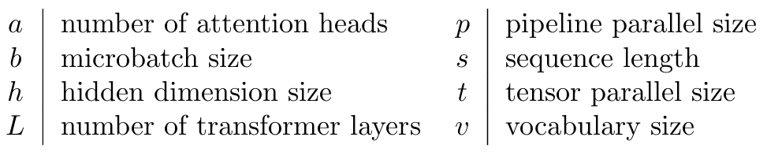
Where Are the Activations?
Some NOTES before we take the journey through the memory usage:
Activations refer to any tensor that are created in the forward and is necessary for gradient computation during back-propagation. So, this excludes the main parameters of the model and optimizer state, but includes the mask used by the dropout operation.
In addition, we only consider the main contributors to the memory and ignore small buffers.
The network and the activations are stored in a fp-16 format and therefore each element requires 2 bytes for storage. The only exceptions are the dropout masks which only require a single byte per element.
Korthikanti, Vijay Anand, Jared Casper, Sangkuk Lym, Lawrence McAfee, Michael Andersch, Mohammad Shoeybi, and Bryan Catanzaro. "Reducing Activation Recomputation in Large Transformer Models." In Proceedings of Machine Learning and Systems 5 (MLSys 2023). 2023.
Notes:
For example, for a layer normalization block, the input to the layer as well as the inputs mean and variance are required to calculate the gradients. The input contains sbh elements whereas mean and variance have only sb elements each. Since h is large (of order of thousands), we have 2sb sbh. As a result it is a good approximation to only consider the memory required to store the input, i.e., we only include sbh, not sbh +2sb.

Slide 7
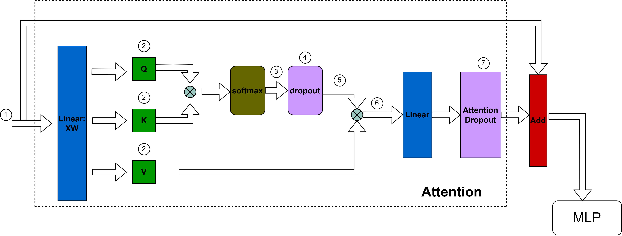
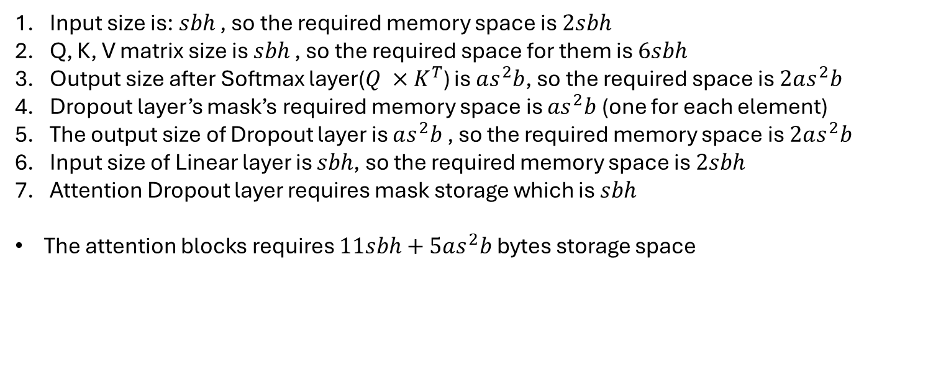
Input size is: $sbh$ , so the required memory space is $2sbh$
Q, K, V matrix size is $sbh$ , so the required space for them is $6sbh$
Output size after Softmax layer($Q ×K^{T}$) is $as^{2}b$, so the required space is $2as^{2}b$
Dropout layer’s mask’s required memory space is $as^{2}b$ (one for each element)
The output size of Dropout layer is $as^{2}b$ , so the required memory space is $2as^{2}b$
Input size of Linear layer is $sbh$, so the required memory space is $2sbh$
Attention Dropout layer requires mask storage which is $sbh$
The attention blocks requires $11sbh+5as^{2}b$ bytes storage space
Korthikanti, Vijay Anand, Jared Casper, Sangkuk Lym, Lawrence McAfee, Michael Andersch, Mohammad Shoeybi, and Bryan Catanzaro. "Reducing Activation Recomputation in Large Transformer Models." In Proceedings of Machine Learning and Systems 5 (MLSys 2023). 2023.

Slide 8
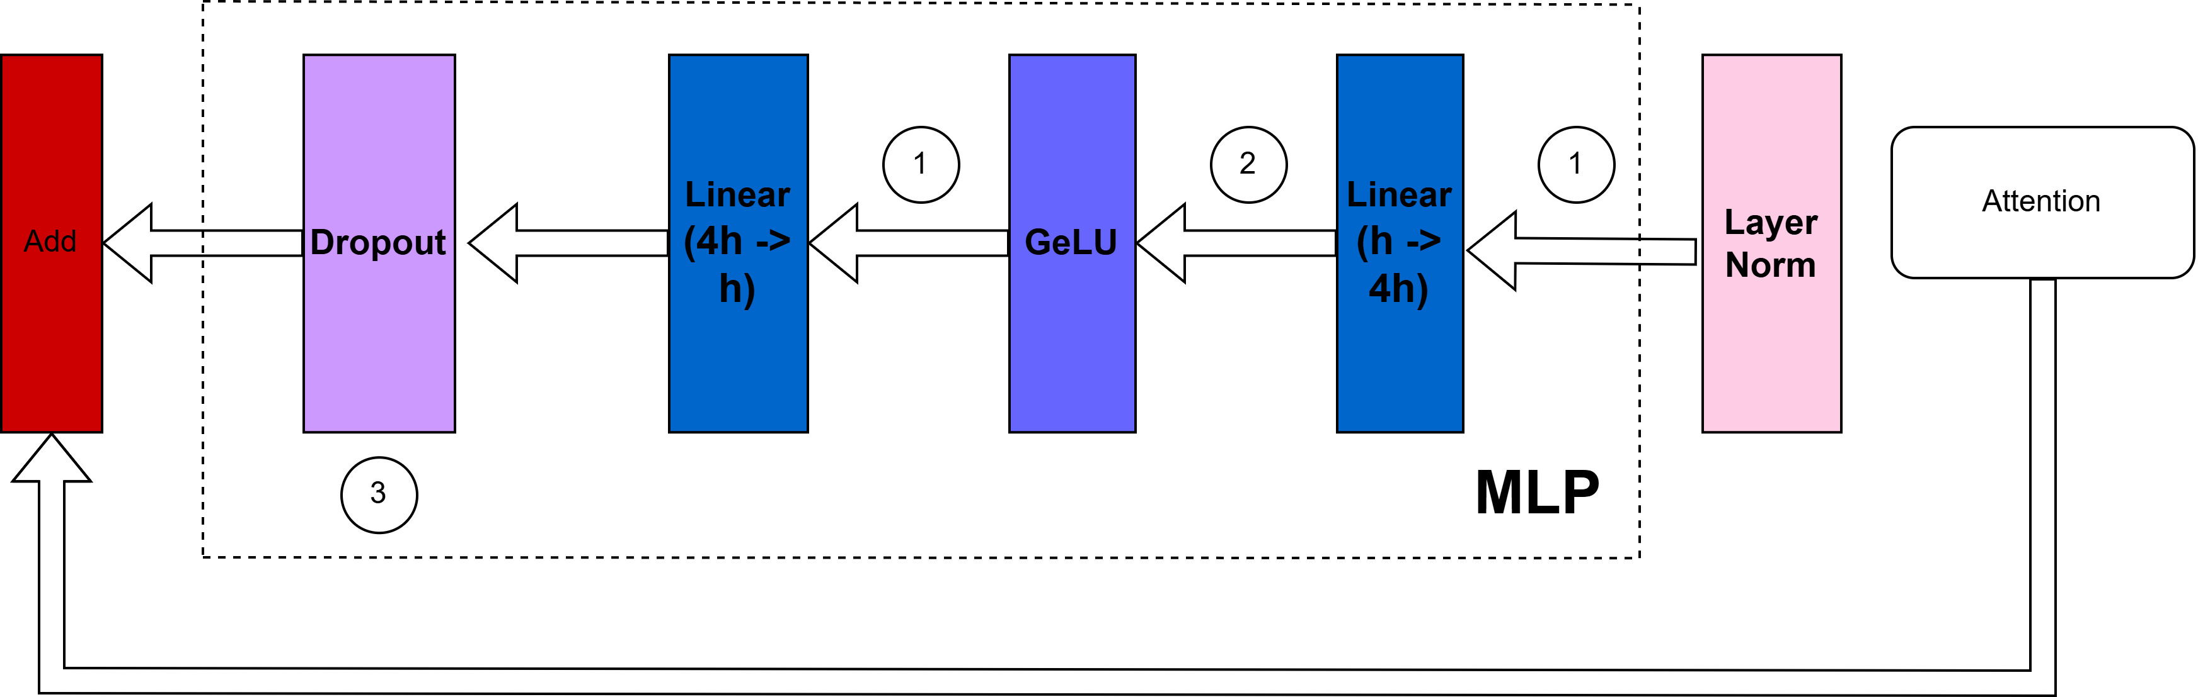
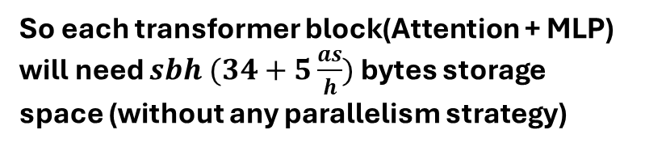
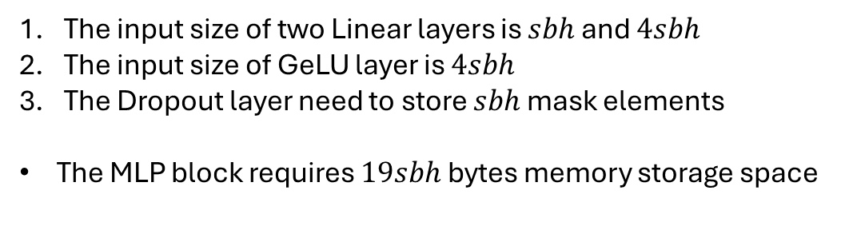
The input size of two Linear layers is $sbh$ and $4sbh$
The input size of GeLU layer is $4sbh$
The Dropout layer need to store $sbh$ mask elements
The MLP block requires $19sbh$ bytes memory storage space
So each transformer block(Attention + MLP) will need $sbh (34+5\frac{as}{h})$ bytes storage space (without any parallelism strategy)
Korthikanti, Vijay Anand, Jared Casper, Sangkuk Lym, Lawrence McAfee, Michael Andersch, Mohammad Shoeybi, and Bryan Catanzaro. "Reducing Activation Recomputation in Large Transformer Models." In Proceedings of Machine Learning and Systems 5 (MLSys 2023). 2023.

Slide 9
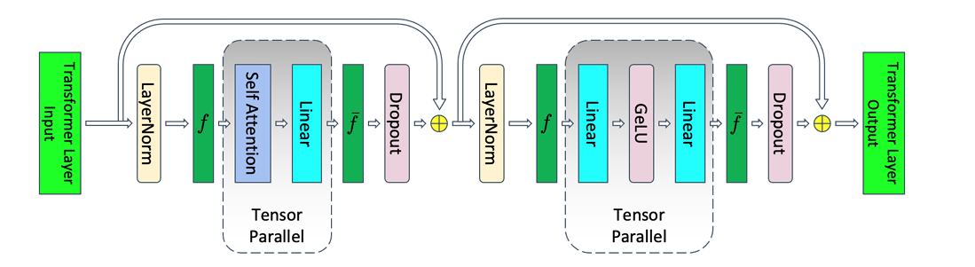
Breaking the Memory Wall!
Activations memory per layer = $sbh\left(10+ \frac{24}{t}+5\frac{as}{ht}\right)$(with tensor parallelism)
Korthikanti, Vijay Anand, Jared Casper, Sangkuk Lym, Lawrence McAfee, Michael Andersch, Mohammad Shoeybi, and Bryan Catanzaro. "Reducing Activation Recomputation in Large Transformer Models." In Proceedings of Machine Learning and Systems 5 (MLSys 2023). 2023.

Slide 10
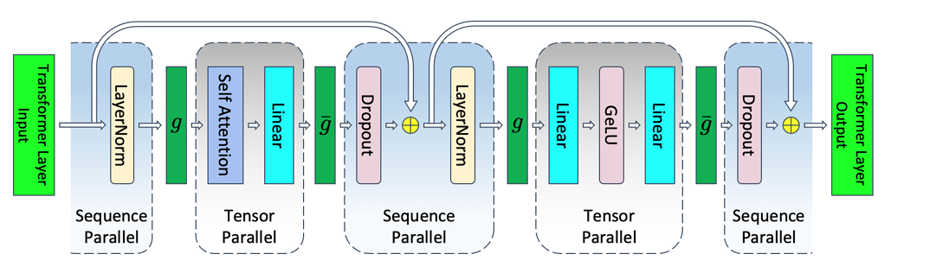
Breaking the Memory Wall!
Sequence parallelism is a technique used to split the sequence length (input tokens) across multiple GPUs during training of large transformer models. Sequence parallelism divides the sequence into smaller chunks, with each GPU handling a portion of the tokens.
Korthikanti, Vijay Anand, Jared Casper, Sangkuk Lym, Lawrence McAfee, Michael Andersch, Mohammad Shoeybi, and Bryan Catanzaro. "Reducing Activation Recomputation in Large Transformer Models." In Proceedings of Machine Learning and Systems 5 (MLSys 2023). 2023.

Slide 11

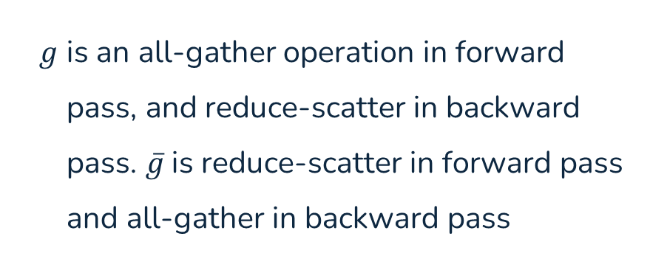
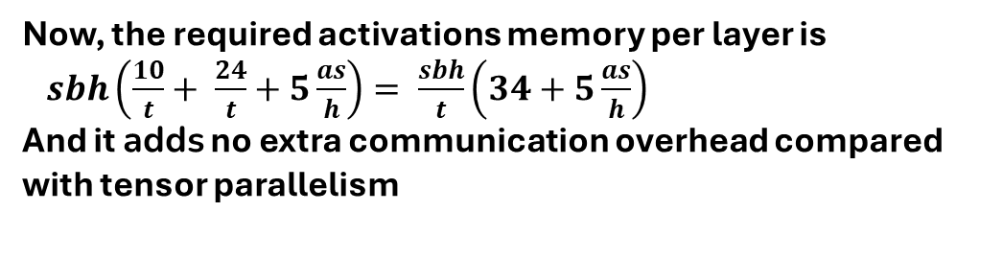
Breaking the Memory Wall!
$g$ is an all-gather operation in forward pass, and reduce-scatter in backward pass. $\overline{g}$is reduce-scatter in forward pass and all-gather in backward pass
Four all-gather and reduce-scatter operations in one transformer block
Now, the required activations memory per layer is $sbh\left(\frac{10}{t}+ \frac{24}{t}+5\frac{as}{h}\right)= \frac{sbh}{t}\left(34+5\frac{as}{h}\right)$
And it adds no extra communication overhead compared with tensor parallelism
Korthikanti, Vijay Anand, Jared Casper, Sangkuk Lym, Lawrence McAfee, Michael Andersch, Mohammad Shoeybi, and Bryan Catanzaro. "Reducing Activation Recomputation in Large Transformer Models." In Proceedings of Machine Learning and Systems 5 (MLSys 2023). 2023.

Slide 12
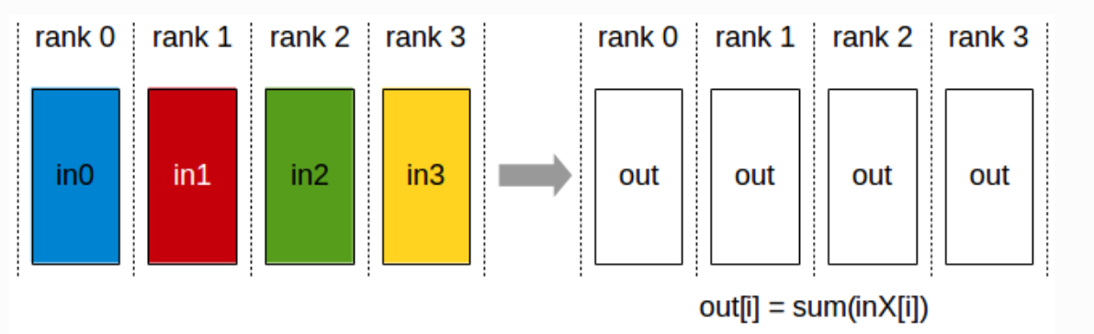
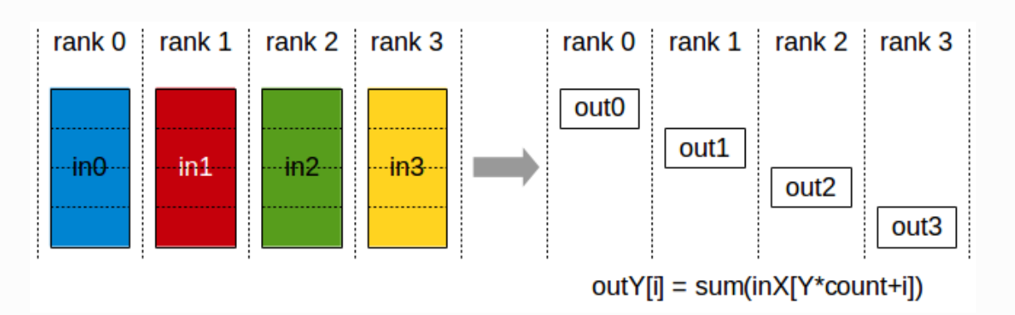
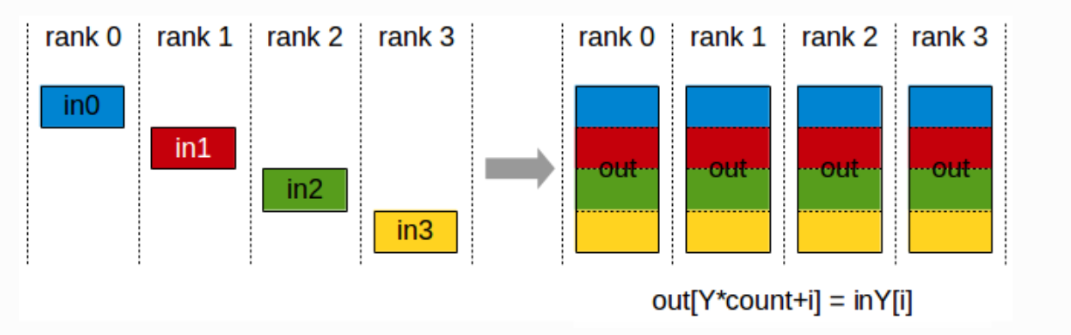
Breaking the Memory Wall!
All-reduce
Reduce-scatter
All-gather
ring all-reduce is composed of two steps: a reduce-scatter followed by an all-gather
Korthikanti, Vijay Anand, Jared Casper, Sangkuk Lym, Lawrence McAfee, Michael Andersch, Mohammad Shoeybi, and Bryan Catanzaro. "Reducing Activation Recomputation in Large Transformer Models." In Proceedings of Machine Learning and Systems 5 (MLSys 2023). 2023.

Slide 13
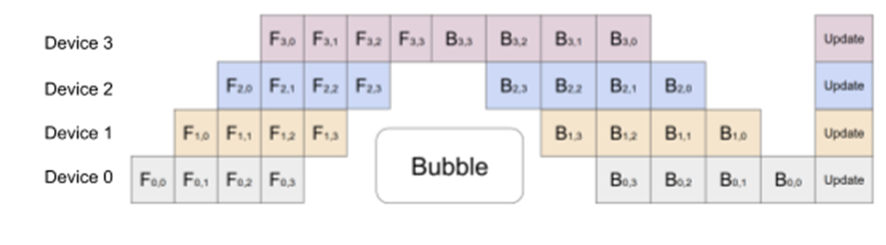
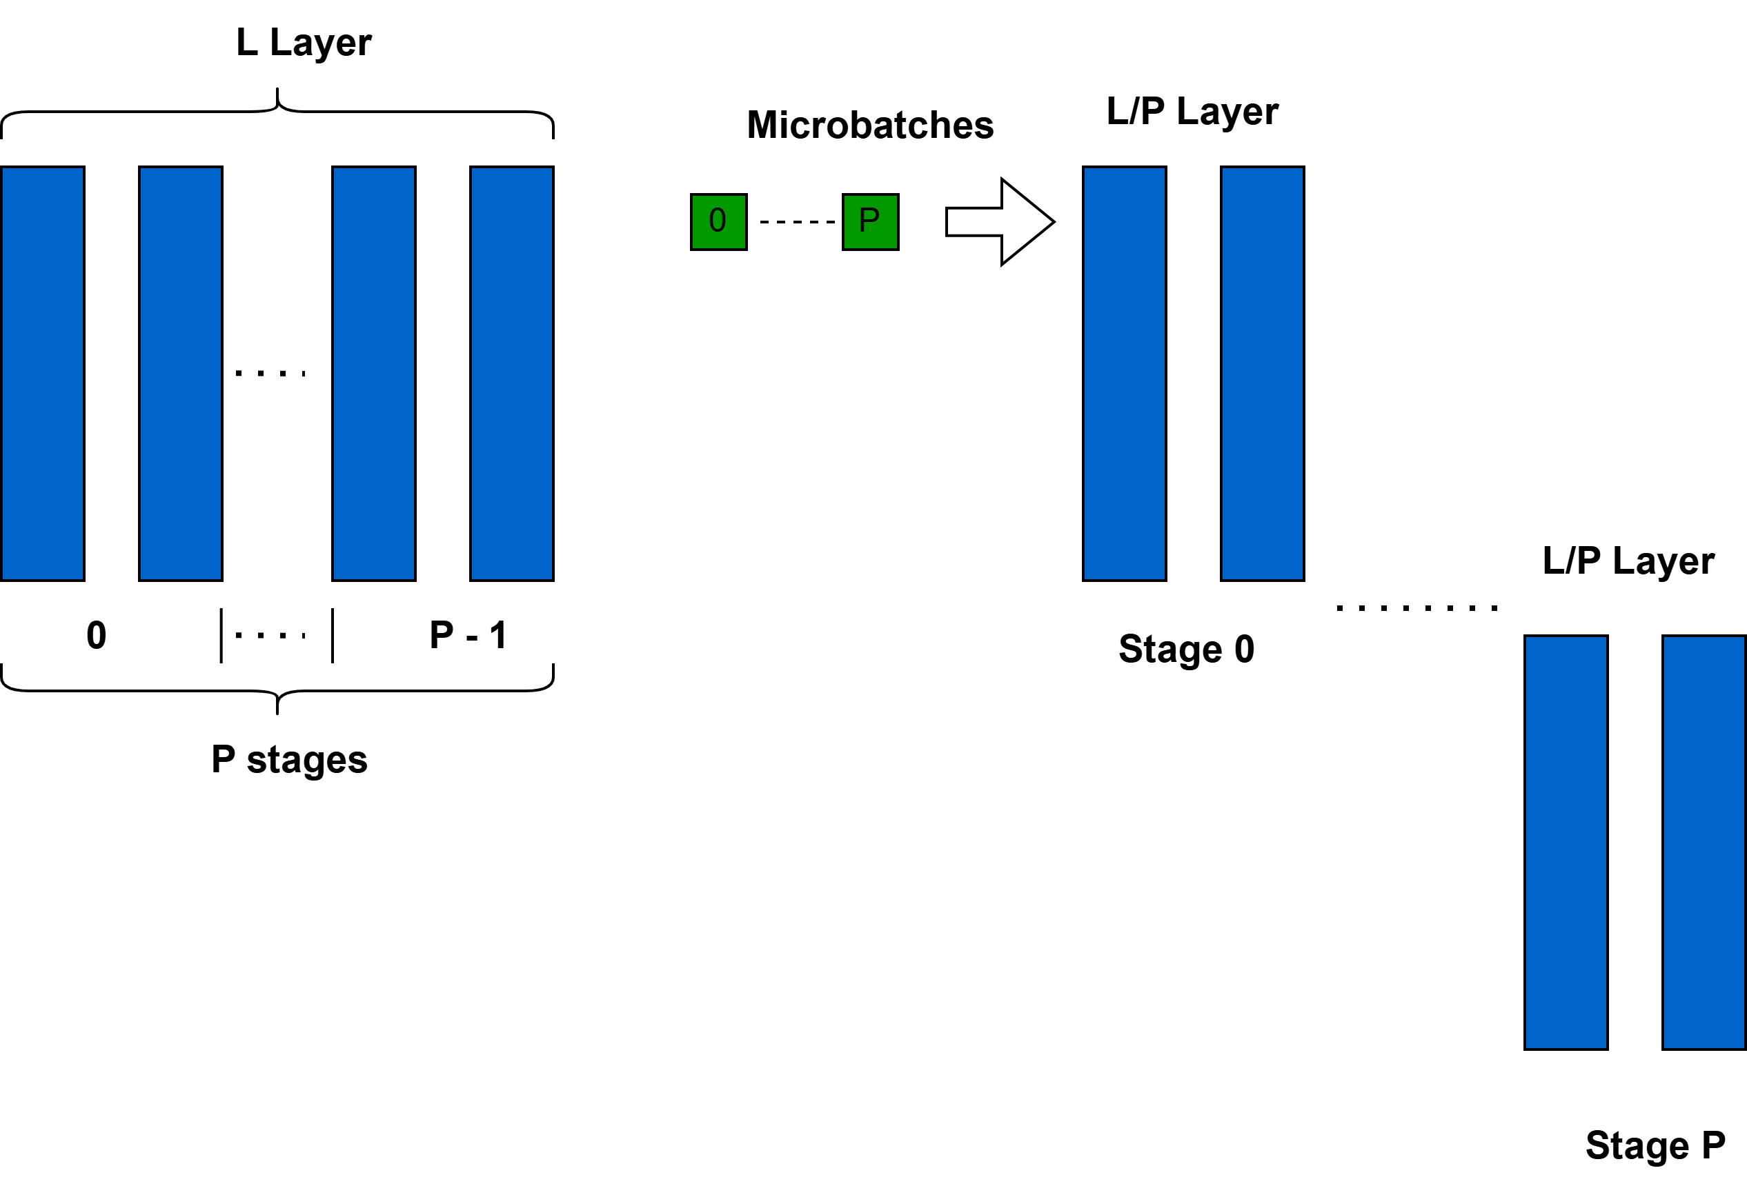
Breaking the Memory Wall!
Pipeline Parallelism
Total activations memory now is $\frac{sbh}{t}\left(34+5\frac{as}{h}\right)$
Korthikanti, Vijay Anand, Jared Casper, Sangkuk Lym, Lawrence McAfee, Michael Andersch, Mohammad Shoeybi, and Bryan Catanzaro. "Reducing Activation Recomputation in Large Transformer Models." In Proceedings of Machine Learning and Systems 5 (MLSys 2023). 2023.

Slide 14
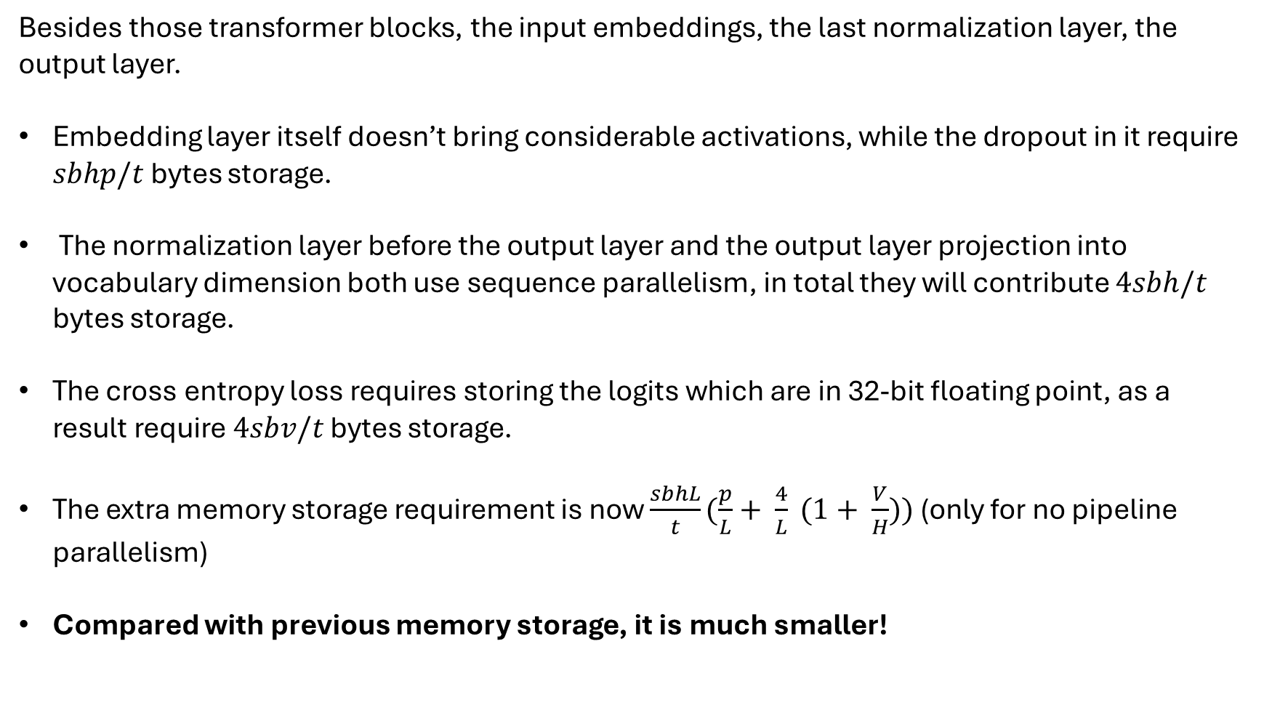
Breaking the Memory Wall!
Besides those transformer blocks, the input embeddings, the last normalization layer, the output layer.
Embedding layer itself doesn’t bring considerable activations, while the dropout in it require $sbhp/t$ bytes storage.
The normalization layer before the output layer and the output layer projection into vocabulary dimension both use sequence parallelism, in total they will contribute $4sbh/t$ bytes storage.
The cross entropy loss requires storing the logits which are in 32-bit floating point, as a result require $4sbv/t$ bytes storage.
The extra memory storage requirement is now $\frac{sbhL}{t}(\frac{p}{L}+ \frac{4}{L} (1+ \frac{V}{H}))$ (only for no pipeline parallelism)
Compared with previous memory storage, it is much smaller!
Korthikanti, Vijay Anand, Jared Casper, Sangkuk Lym, Lawrence McAfee, Michael Andersch, Mohammad Shoeybi, and Bryan Catanzaro. "Reducing Activation Recomputation in Large Transformer Models." In Proceedings of Machine Learning and Systems 5 (MLSys 2023). 2023.

Slide 15
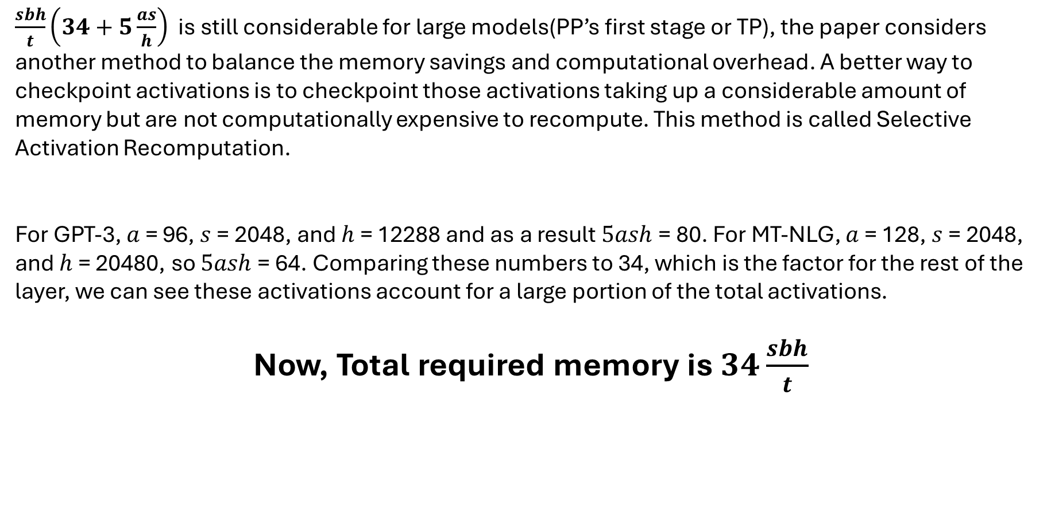
Breaking the Memory Wall!
Selective Activation Recomputation
$\frac{sbh}{t}\left(34+5\frac{as}{h}\right)$ is still considerable for large models(PP’s first stage or TP), the paper considers another method to balance the memory savings and computational overhead. A better way to checkpoint activations is to checkpoint those activations taking up a considerable amount of memory but are not computationally expensive to recompute. This method is called Selective Activation Recomputation.
For GPT-3, $a$ = 96, $s$ = 2048, and $h$ = 12288 and as a result $5ash$ = 80. For MT-NLG, $a$ = 128, $s$ = 2048, and $h$ = 20480, so $5ash$ = 64. Comparing these numbers to 34, which is the factor for the rest of the layer, we can see these activations account for a large portion of the total activations.
Now, Total required memory is $34\frac{sbh}{t}$
Korthikanti, Vijay Anand, Jared Casper, Sangkuk Lym, Lawrence McAfee, Michael Andersch, Mohammad Shoeybi, and Bryan Catanzaro. "Reducing Activation Recomputation in Large Transformer Models." In Proceedings of Machine Learning and Systems 5 (MLSys 2023). 2023.

Slide 16
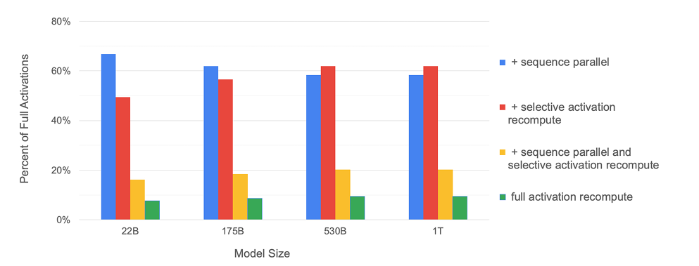
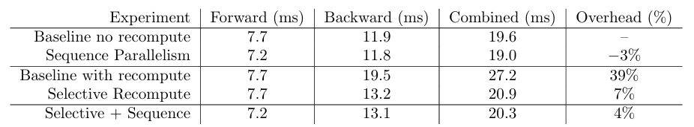
Lighter memory, Faster training!
Both sequence parallelism and selective activation recomputation have similar memory savings and together they reduce the memory required by 5x .
Percentage of required memory compared to the tensor-level parallel baseline
Time to complete the forward and backward pass of a single transformer layer of the 22B model
Korthikanti, Vijay Anand, Jared Casper, Sangkuk Lym, Lawrence McAfee, Michael Andersch, Mohammad Shoeybi, and Bryan Catanzaro. "Reducing Activation Recomputation in Large Transformer Models." In Proceedings of Machine Learning and Systems 5 (MLSys 2023). 2023.

Slide 17
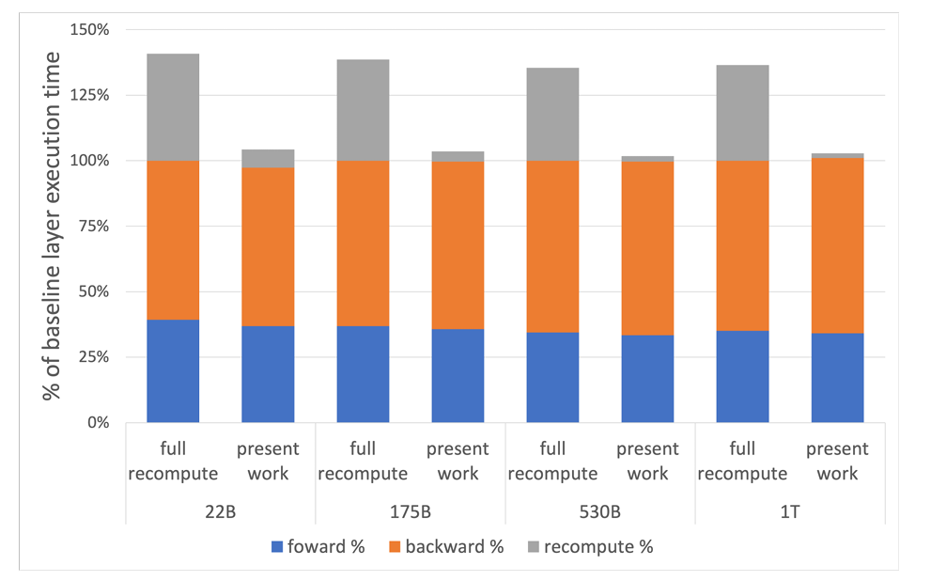
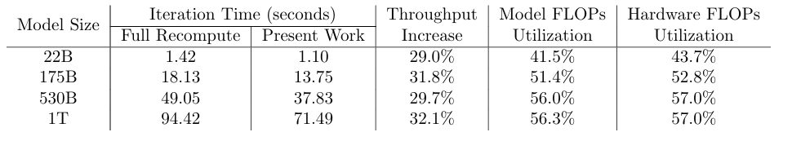
Lighter memory, Faster training!
Per layer breakdown of forward, backward, and recompute times.
Baseline is the case with no recomputation and no sequence parallelism.
Present work includes both sequence parallelism and selective activation recomputation
Korthikanti, Vijay Anand, Jared Casper, Sangkuk Lym, Lawrence McAfee, Michael Andersch, Mohammad Shoeybi, and Bryan Catanzaro. "Reducing Activation Recomputation in Large Transformer Models." In Proceedings of Machine Learning and Systems 5 (MLSys 2023). 2023.

Slide 18
What’s more?
Some unexplored questions in this paper:
Memory fragmentation for large microbatches training
Non-uniform memory allocation due to pipeline parallelism, e.g. the first stage of PP is not optimized very much
Korthikanti, Vijay Anand, Jared Casper, Sangkuk Lym, Lawrence McAfee, Michael Andersch, Mohammad Shoeybi, and Bryan Catanzaro. "Reducing Activation Recomputation in Large Transformer Models." In Proceedings of Machine Learning and Systems 5 (MLSys 2023). 2023.

Slide 19
Thank you!

Slide 20
